Slide 1
Capstone Project-1
Global Terrorism Analysis
Team Member
Mayur Prakash Parande
Shubham Shrivastava
Prasad I Ganachari
Praful Mahendra Gedam

Slide 2
What we analysis
The GTD includes systematic data on domestic as well as international terrorist incidents that have occurred during this time period and now includes more than 180,000 attacks. The database is maintained by researchers at the National Consortium for the Study of Terrorism and Responses to Terrorism (START), headquartered at the University of Maryland.

Slide 3
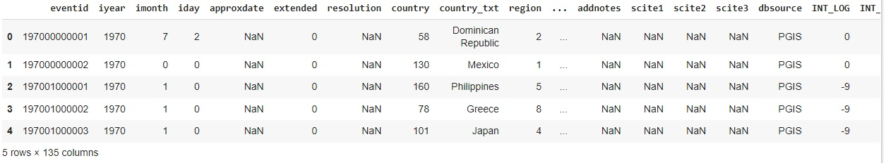
Encoding of Dataset

Slide 4
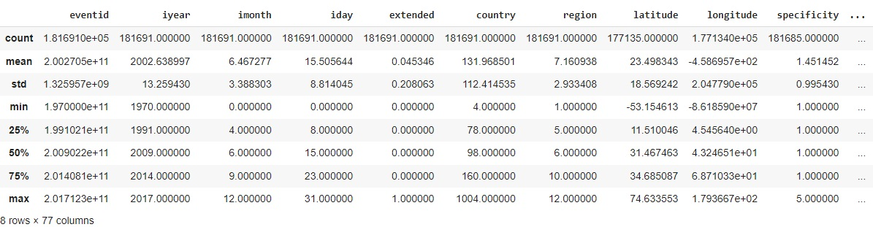
Create Checkpoint

Slide 5
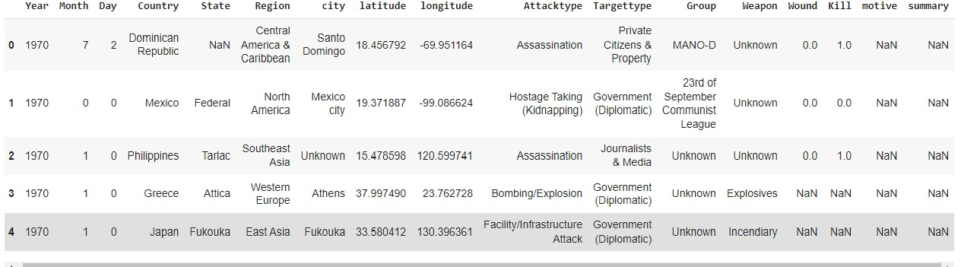
Rename columns for better understanding Consider only those columns which are necessary for Analysis

Slide 6
Data Pipeline
Data Processing –I: in this first part we have a rename a data row and remove a unnecessary data and create large table well stretchered.
Data Processing –II: in this part, we manually change a data and make a static chart according a data.
EDA: in this part, we do some exploratory data analysis (EDA) on the features
Data Analysis selected part-I and II to see Globally.
Create a Visually Charts: Finally we got a last part but not the end. we visual the data through charts how to a global terrorism attack in world in this data we hope to help of to stop a terrorism.

Slide 7
Data Summary
on. In this project, we tried to explore a dataset containing information about global terrorism acts since 1970, and attempted to make the findings as visual as possible. The dataset used is called the Global Terrorism Database, and contains over 100,000 terrorist incidents worldwide, with over 100 different attributes for each incident. The results include 7 plots in total. All of them being both very interesting and informative !

Slide 8
The pre or (zero) part of this project before EDA was to familiarize ourselves with the dataset in order to analyse or get some insights from the huge set of data.
As the first step we started with Data Wrangling over the raw chunks of data, the process of which includes searching for and getting the sum of total null values present in the data set, renaming some of the columns and selecting only the columns which are necessary and filling suitable missing data.
With all of the time series information and geographical information, we knew that the best and most interesting way to understand this data would be by using visualizations.

Slide 9
So in the next step we started with country wise attacks analysis, through this we concluded the country which is under severe threat.
Followed by month wise attack analysis, through which we found out the particular month or time of the year in which the terrorists were most active.
Further in the groupwise attacks analysis a bar-graph was plotted considering different terrorists groups active and the number of attacks, we found which group was responsible for most number of attacks.
In the next step of region wise attacks analysis, we plotted a heat-map ranging from year 1970-2020 through we could clearly identify the region which is under most number of attacks and also the regions which are under constant threat.

Slide 10
Further in the next step, of number of killings by attacks analysis we plotted a bar-graph of the number of deaths each year caused by terrorist attacks. Here we could identify a stark rise in number of deaths in a particular year.
Also we plotted a bar graph indicating the number of deaths caused vs the type of attacks. Through which we found out a stark difference in the methods of attacks and also the damage caused by different methods, which could also help us in identifying and preventing further attacks.

Slide 11
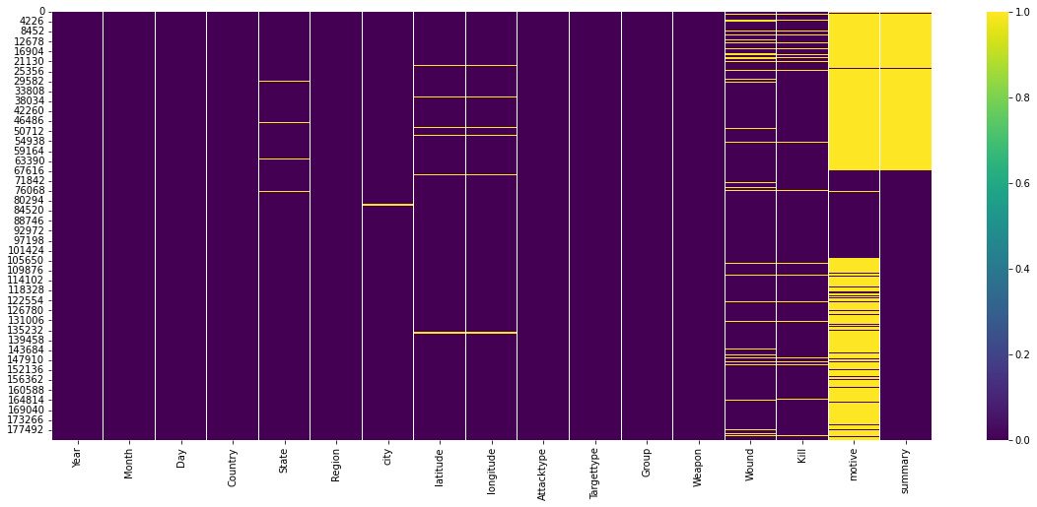
CONCLUSION
Null columns in our datasets are: 1.Latitude 2.Longitude 3.Wound 4.Kill 5.Motive 6.Summary
Most null values are in Motive and Summary so we drop it. Latitude and Longitude has no use in our analysis so we drop it

Slide 12
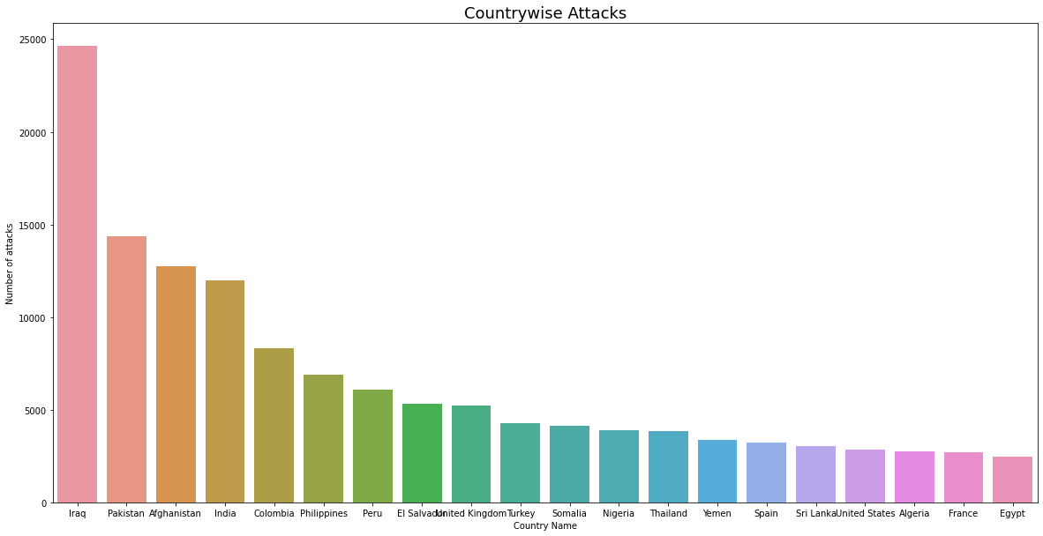
This is Chart Country wise Attack

Slide 13
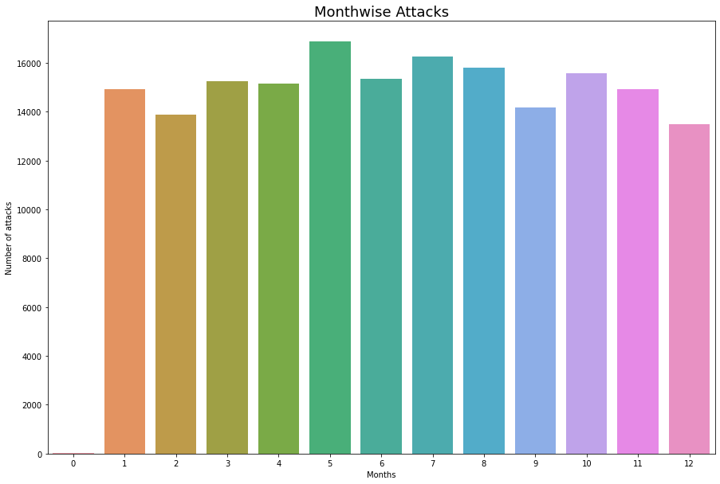
This Chart is showing Month wise Attacks

Slide 14
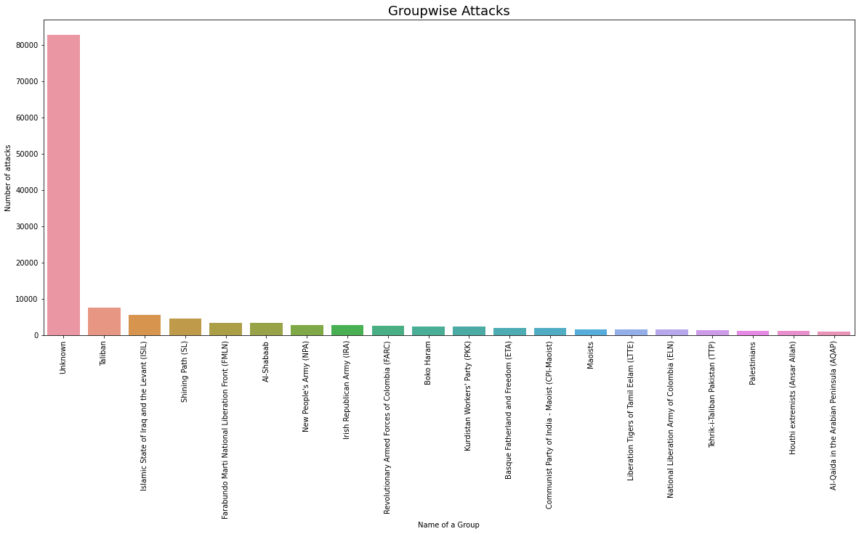
This chart is showing Group Wise Attacks

Slide 15
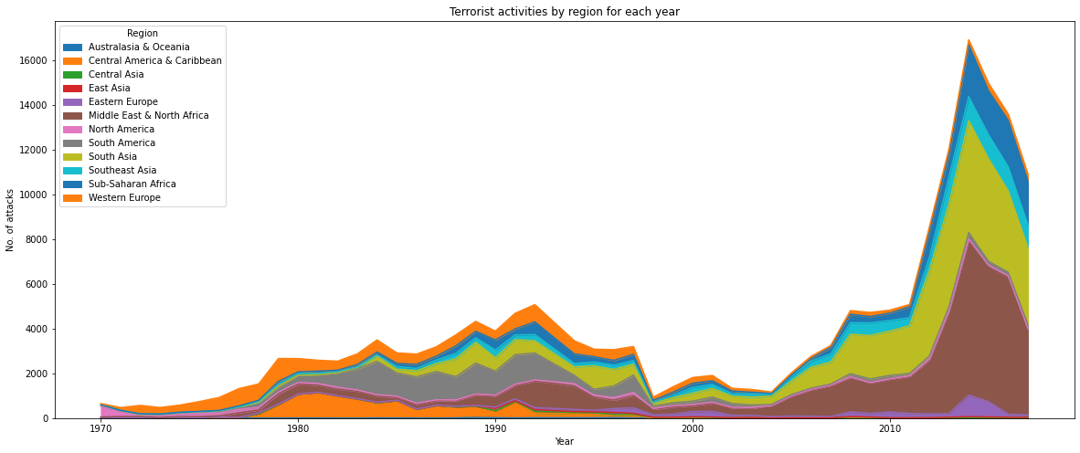
Terrorist activities by region for each year

Slide 16
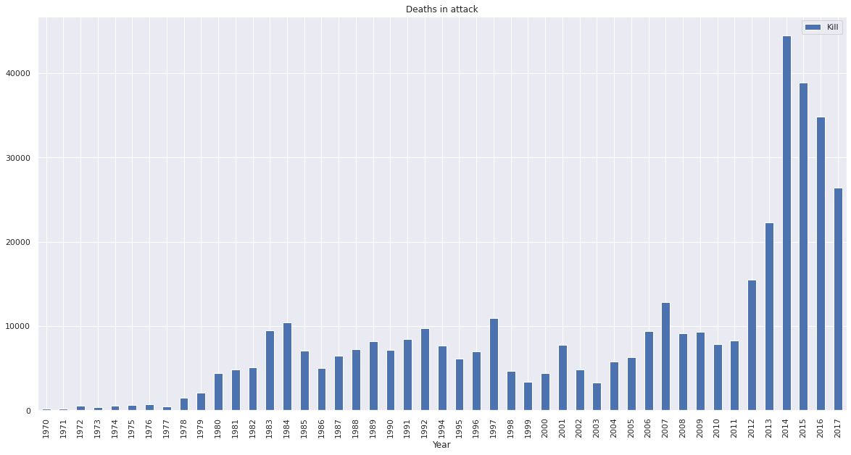
Deaths in attack per year

Slide 17
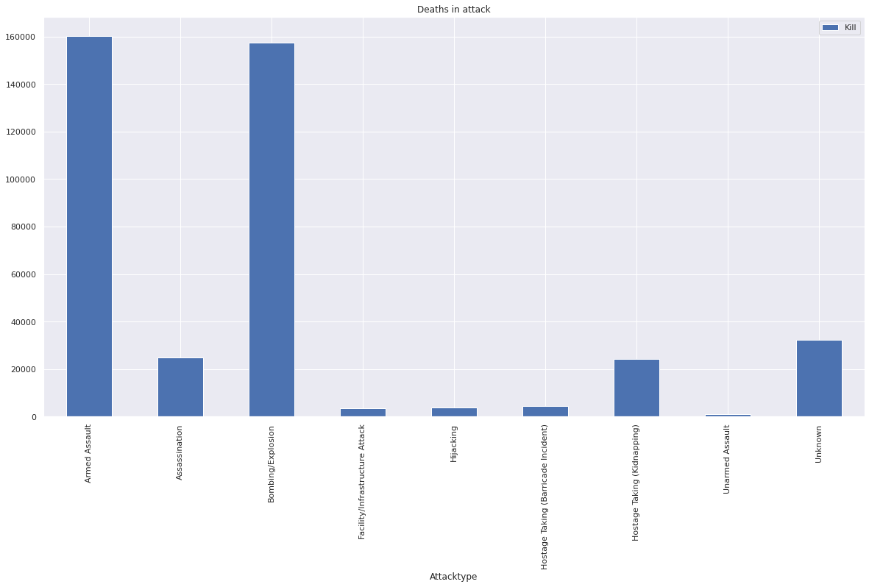
Deaths in attack according to Attacktype

Slide 18
Conclusion
Data visualization on analysis is best tool to undertaken findings from the analysis.
After analysing Global Terrorism Data, the major finding we got is that terror attacks were increased exponentially which eventually leads deaths per years.
The most common attack type which we got after analysis are Bombing/Explosion and Armed assault.

Slide 19
Challenges
we have lots of challenges in this project first Data Set and Data Handling and sort and filtering also
Big Challenges is identify a null values and show a static Pivot chart with numerical firures.

Slide 20
Thank you

